Slide 1


Shark Tank US

Slide 2

Today's agenda
Project recap
Project objective
Process
Insights
Data overview
Summary

Slide 3

This dataset provides comprehensive information about the American business reality television series, Shark Tank, covering seasons 1 to 14. The dataset includes 50 columns and over 1260 records, capturing various details about each episode, pitch, and deal made on the show.
Project Recap

Slide 4


Project Objective
To analyze startup investment trends from Shark Tank using historical pitch data, with a focus on identifying top-performing industries, founder demographics, investment patterns, and regional startup distribution. The goal is to uncover insights into what types of startups receive funding, how gender and geography affect deal success, and how valuation relates to investment decisions.
Tools: Python, Power BI, Data Cleaning, DAX

Slide 5

Process
1
Data Collection
2
Data Understanding
3
Data Cleaning
4
Data Visualization
5
Uncover Insights

Slide 6
Data Overview
Data Source:
Shark tank US dataset (scrapped from the Kaggle)
Total Records:
1,274 Rows
Key Columns Used:
Season Number: The number of the season (14 Season)
Pitch Number: The overall pitch number (1.274 K)
Industry: The industry name or type
Pitchers Gender: The gender of the pitchers
Pitchers State: The US state or country of the pitchers, represented by a two-letter shortcut
Total Deal Amount: The total deal amount in USD (USD 226 M)
Number of sharks in deal: The number of sharks involved in the deal
Investment Amount Per Shark: The investment amount per shark

Slide 7
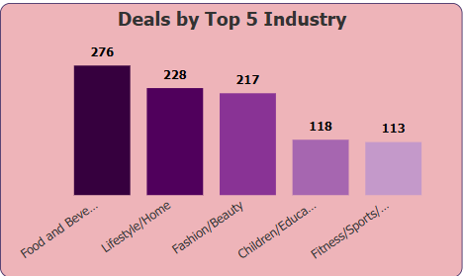
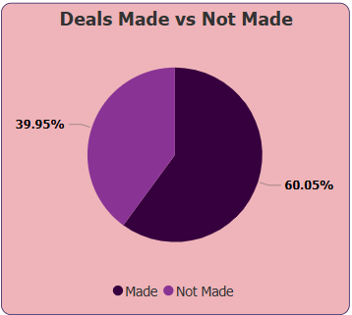
Insights
Top Industries Securing the Most Deals
Food & Beverage dominates with 276 deals, showing strong investor interest in consumable products
Lifestyle/Home and Fashion/Beauty sectors also received high attention, reflecting consumer-focused business appeal
Children/Education and Fitness/Sports/Outdoors round out the top 5, indicating growing traction in wellness and learning spaces
Deal Conversion Rate
60.05% of the pitches successfully secured a deal
39.95% of the pitches did not result in a deal
These indicates a relatively high conversion rate, suggesting investors are actively funding promising startups

Slide 8
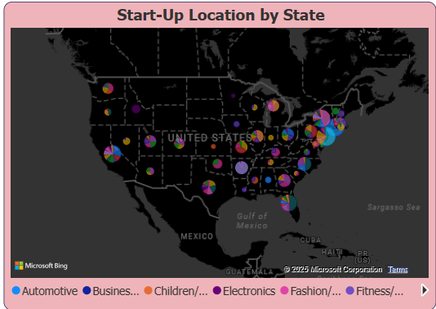
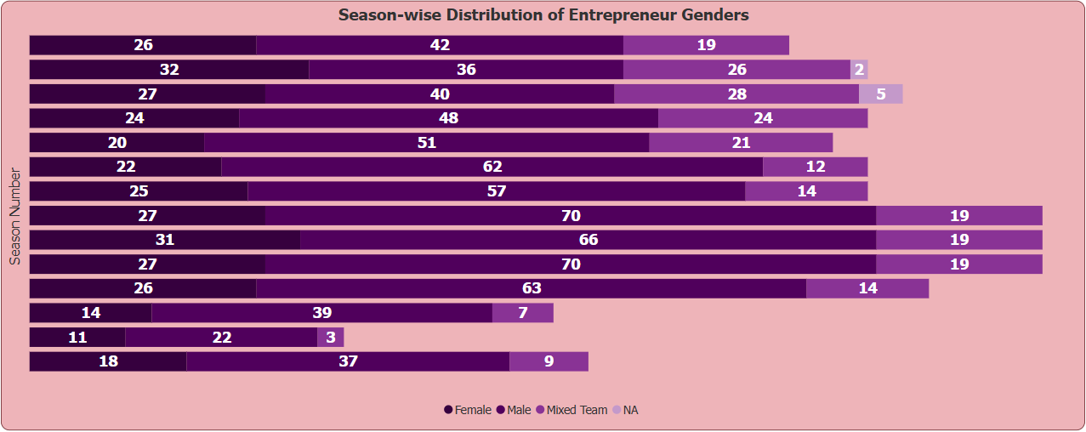
Geographic Distribution of Start-Ups by State
Start-ups are densely concentrated on the East and West Coasts, especially in California, New York, and Florida.
California leads in start-up variety and volume, showcasing a diverse entrepreneurial ecosystem.
Eastern states like New York, Pennsylvania, and Georgia also show high start-up activity.
The pie chart representation highlights industry diversity across states.
Entrepreneur Gender Trends Across Seasons
Male entrepreneurs consistently dominate across all seasons, but there is noticeable participation from female and mixed-gender teams, especially in recent seasons.
Season 12, 13, and 14 show a balanced trend, with a steady rise in mixed-gender teams and more female-led pitches.
Earlier seasons (1–5) had lower representation of mixed or female teams, showing positive progression toward inclusivity over time.
Seasons 6–10 have the highest number of male-only pitches, but also show an emerging presence of diverse teams.

Slide 9
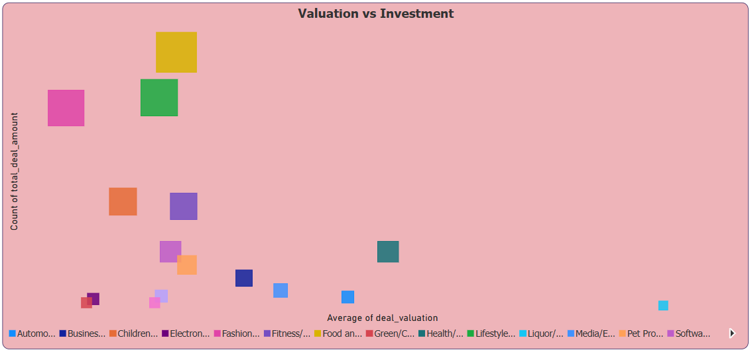
Valuation vs Investment by Industry (Bubble Size: Viewership)
Food & Beverage and Lifestyle sectors have high average investments and also large viewership, suggesting these pitches attract significant investor and audience attention
Fashion and Health industries received a large number of deals, indicating strong investor interest, even at moderate valuation levels
Some sector like Media/Entertainment show high valuations but fewer deals, possibly indicating tougher negotiation or niche appeal
Viewership (bubble size) correlates strongly with popular consumer sectors, showing what attracts both investors and the public

Slide 10
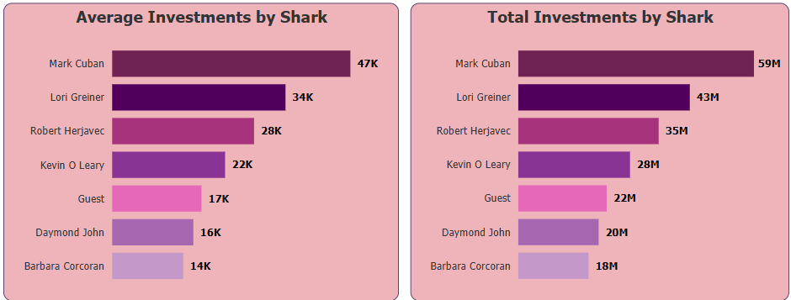
Investment Power Rankings: Sharks by Average vs Total
Mark Cuban ranks number 1 in both average and total investments, proving he’s the most consistent and aggressive investor
Barbara Corcoran and Daymond John appear on the lower end of both charts, suggesting fewer and smaller investments - possibly more strategic or cautious
Lori Greiner’s investment style holds number 2 rank in both total and average investment showing a balanced approach with frequent mid-sized deals.
Guest Sharks beat some regular sharks in average investment and total contributions, showing high-impact participation despite limited appearances.

Slide 11
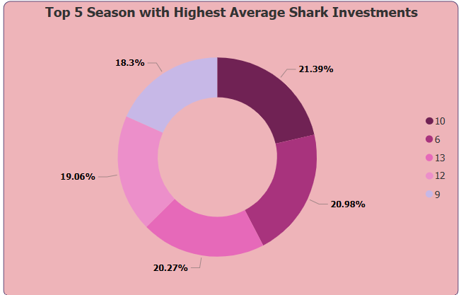
Top 5 Season with Highest Average Shark Investments
Season 10 leads with the highest average investment per shark, followed closely by Seasons 6 and 13, reflecting peak confidence and high-value pitches
Higher average investments often align with mature seasons where sharks were more confident or impressed by startups' quality.

Slide 12
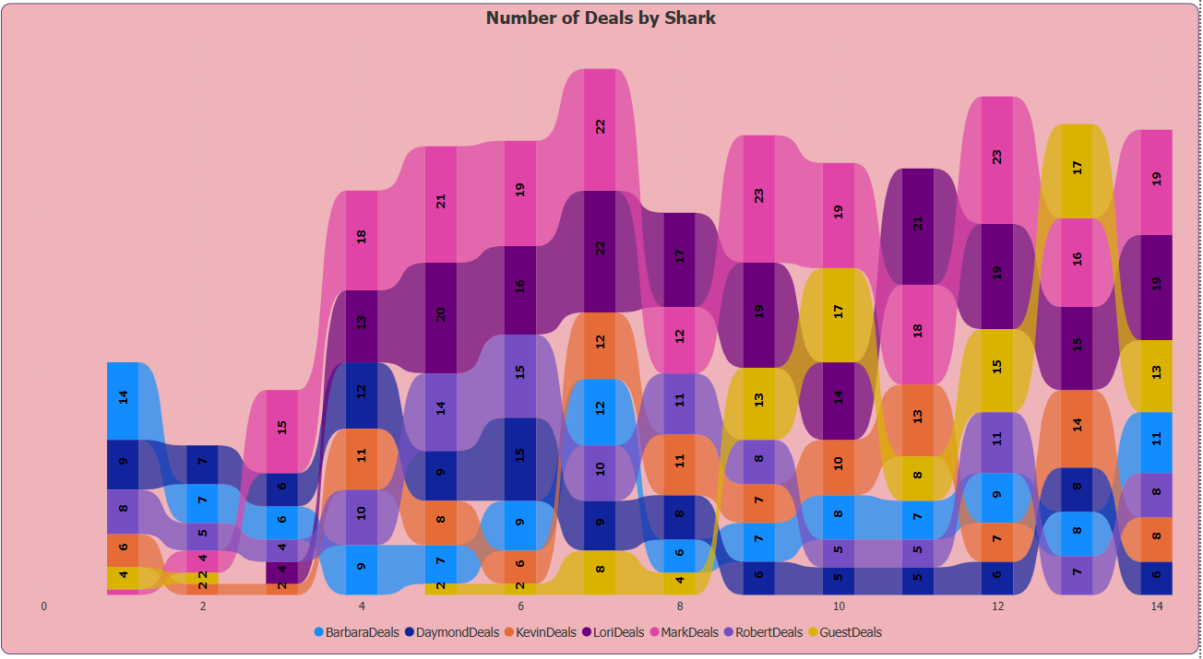
Deal-Making Trends Across Seasons (Consistency of Sharks)
Mark Cuban has consistently stayed one of the top deal-makers in every season.
Lori Greiner also shows strong consistency and high deal volume, nearly matching or beating Mark in several seasons.
Robert Herjavec participated actively early on, peak around Seasons 5–7, but shows variability afterward.
Guest Sharks showed noticeable increase in recent seasons (11–14). Their participation and deal-making have risen significantly, suggesting increased reliance on guest investors.
Barbara Corcoran & Daymond John both show lower and less consistent deal activity, possibly indicating more selective investing styles.
Kevin O'Leary maintains a mid-range deal volume but consistent presence.

Slide 13

Investors prefer sectors with broad consumer appeal and daily utility. Startups in food, lifestyle, and beauty continue to attract the most funding interest.
Majority of the startups pitching on Shark Tank receive investments, reflecting strong investor confidence and market-ready ideas.
Mainly start-ups are spread across the U.S., however, coastal states dominate the entrepreneurial landscape, driven by better investor access, infrastructure, and supportive ecosystems
Sectors like food, lifestyle, and health not only secure frequent investments but also captivate the audience, highlighting a blend of market viability and viewer engagement
There’s a gradual shift toward gender diversity among entrepreneurs on Shark Tank, reflecting a more inclusive entrepreneurial landscape over time.
Sharks with higher average but lower total might be more selective, while those with higher totals but lower averages may be more opportunity-driven
Mark Cuban and Lori Greiner showed the most consistent and high deal-making across seasons, especially dominating in later ones. Kevin O’Leary maintained a steady pace, while Barbara and Daymond showed more selective trends. Guest sharks gained prominence from Season 10 onward, increasing deal activity noticeably
Season 10 saw the highest average investment per shark, indicating a peak in investor confidence and deal value.
Summary

Slide 14
Thank you!
ANY QUESTIONS?

